Slide 1
Combinational Logic
Himanshu K. Gajera
Department of Computer Science & Engineering
Pandit Deendayal Energy University, Gandhinagar

Slide 2
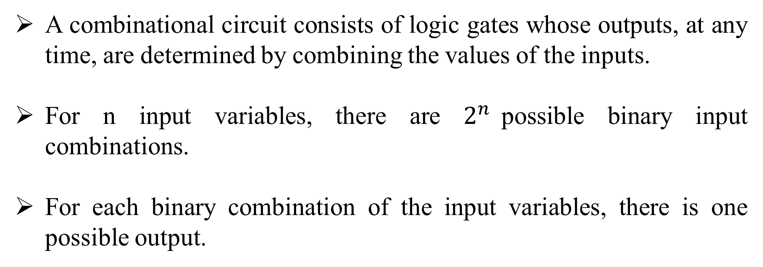
Introduction
A combinational circuit consists of logic gates whose outputs, at any time, are determined by combining the values of the inputs.
For n input variables, there are $2^{n}$possible binary input combinations.
For each binary combination of the input variables, there is one possible output.

Slide 3
Introduction
Hence, a combinational circuit can be described by:
A truth table that lists the output values for each combination of the input variables, or
m Boolean functions, one for each output variable.
Combinational
Circuit
n-inputs
•
m-outputs
•
•
•
•
•

Slide 4
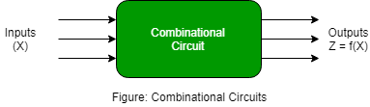
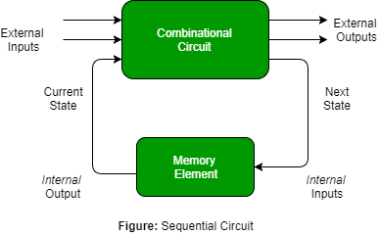
Introduction

Slide 5
Design procedure
The procedure involves the following steps:
State the problem.
Determine no. of available input variables and required output variables.
Assign letter symbols to the input and output variables.
Derive the truth table that defines the required relationship between inputs and outputs.
Obtain simplified Boolean function for each output.
Draw the logic diagram.

Slide 6
Adders (half adder)
It is a arithmetic combinational logic circuit designed to perform addition of two single bits.
It contain two inputs and produces two outputs.
Inputs are called Augend and Added bits and Outputs are called Sum and Carry.
Addition of single bits
0+0= 0
0+1= 1
1+0= 1
1+1=10
The result of 1+1 is 10, where ‘1’ is carry-output (Cout) and ‘0’ is Sum-output

Slide 7
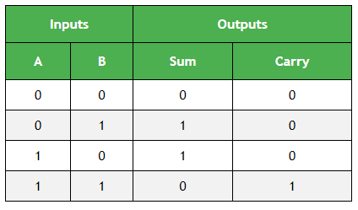
Adders (half adder)
Truth Table of Half Adder:

Slide 8
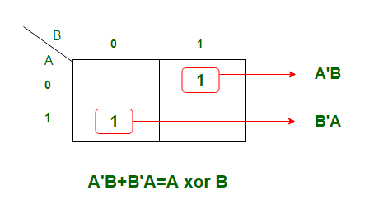
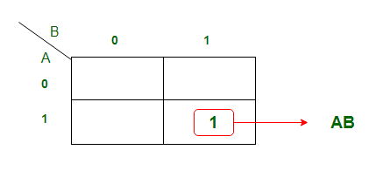
Adders (half adder)
K-map for output variable Sum ‘S’:
K-map is of Sum of products form. The equation obtained is
S = AB' + A’B == S = A xor B
K-map for output variable Carry ‘C’:
The equation obtained from K-map is
C = AB

Slide 9
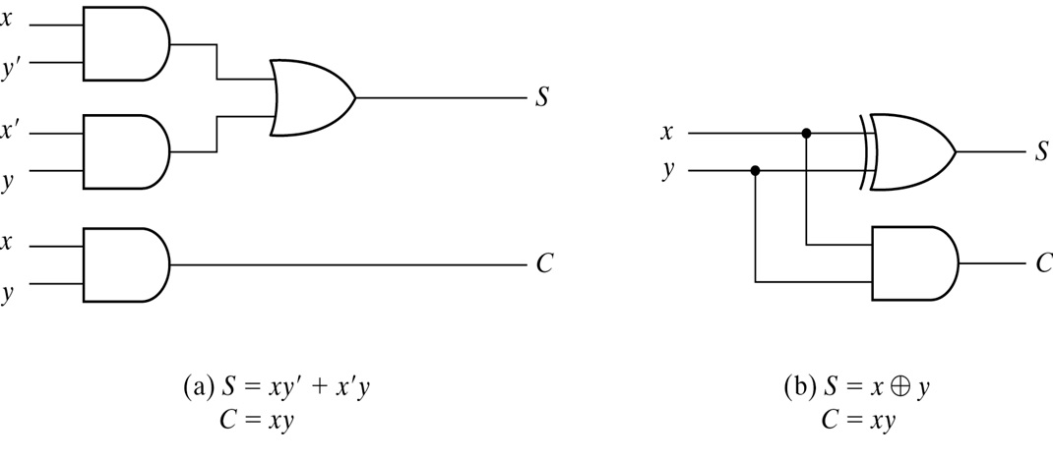
Implementation of HALF ADDER

Slide 10
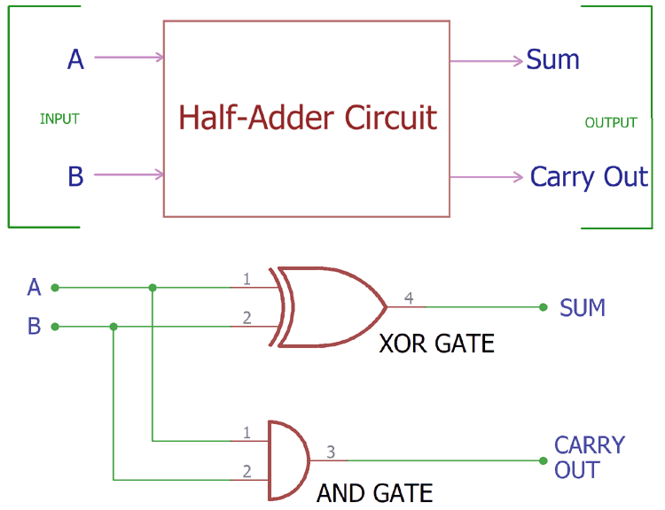
Implementation of HALF ADDER
Limitations: Adding of Carry is not possible in Half adder.

Slide 11
Adders (full adder)
To overcome the above limitation faced with Half adders, Full Adders are implemented.
It is a arithmetic combinational logic circuit that performs addition of three single bits.
It contains three inputs (A, B, C_{in}) and produces two outputs (Sum and C_{out}).
Where, C_{in} -> Carry In and C_{out} -> Carry Out

Slide 12
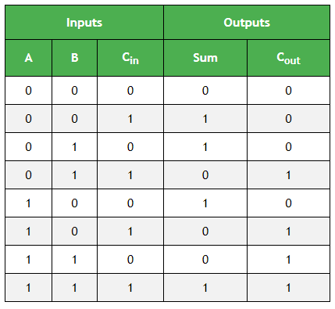
Adders (full adder)
Truth table of Full Adder:

Slide 13
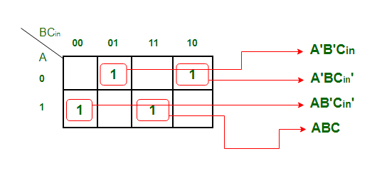
Adders (full adder)
K-map Simplification for output variable Sum ‘S’ :
The equation obtained is
S = A'B'C_{in} + AB'C_{in}' + ABC + A'BC_{in}'
The equation can be simplified as
S = B'(A'C_{in}+AC_{in}') + B(AC + A'C_{in}’)
S = B'(A xor C_{in}) + B (A xor C_{in})’
S = A xor B xor C_{in}

Slide 14
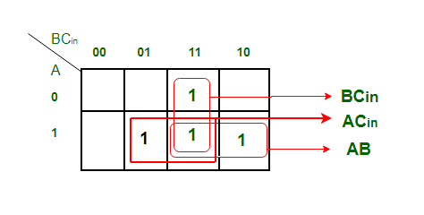
Adders (full adder)
K-map Simplification for output variable ‘Cout‘
The equation obtained is
C_{out} = BC_{in} + AB + AC_{in}

Slide 15
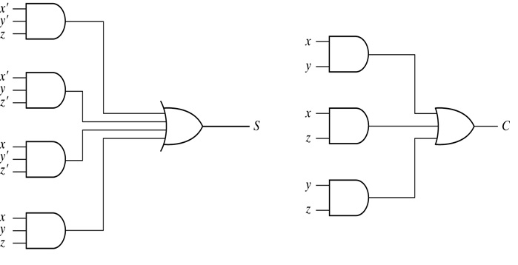
Adders (full adder)

Slide 16
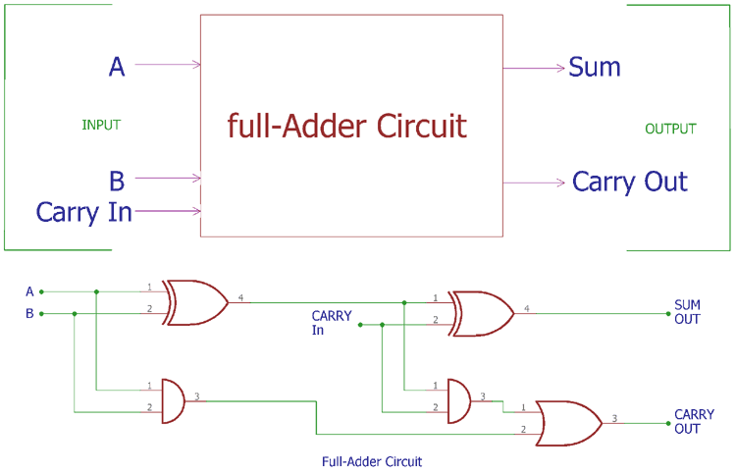
Adders (full adder)

Slide 17
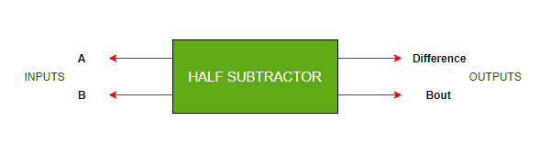
Half Subtractor
It is a combinational logic circuit designed to perform the subtraction of two single bits.
It contains two inputs (A and B) and produces two outputs (Difference and Borrow-output).

Slide 18
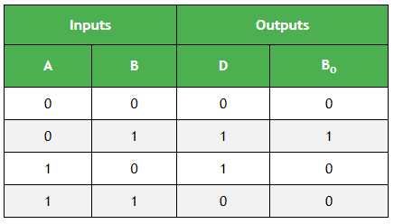
Half Subtractor
Truth Table of Half Subtractor:

Slide 19
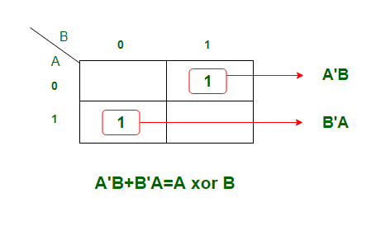
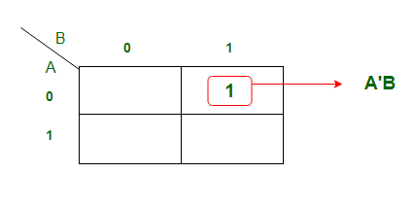
Half Subtractor
K-map Simplification for output variable ‘D’:
K-map Simplification for output variable ‘Bout‘ :

Slide 20
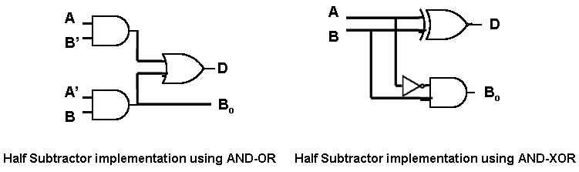
Half Subtractor
Implementation of HALF SUBTRACTOR
(a)
D = A’B+AB’
B = A’B
(b)
D = A’B+AB’
B = A’B

Slide 21
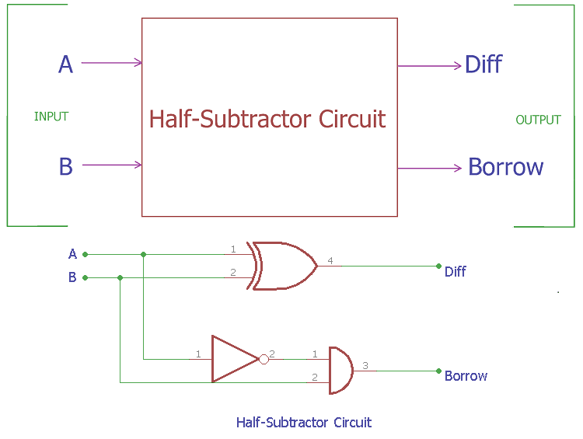
Half Subtractor
Implementation of HALF SUBTRACTOR

Slide 22
Full Subtractor
It is a Combinational logic circuit designed to perform subtraction of three single bits.
It contains three inputs(A, B, B_{in}) and produces two outputs (D, B_{out}).
Where, A and B are called Minuend and Subtrahend bits.
And, B_{in} -> Borrow-In and B_{out} -> Borrow-Out

Slide 23
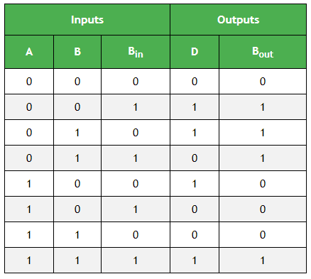
Full Subtractor
Truth Table of Full Subtractor:

Slide 24
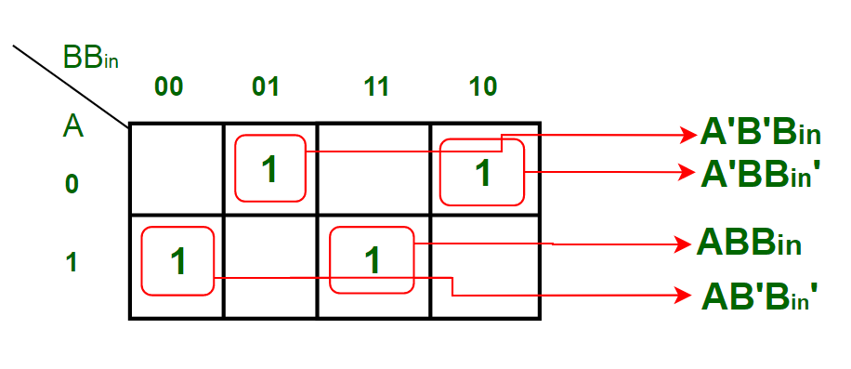
Full Subtractor
K-map Simplification for output variable ‘D’ :
The equation obtained from above K-map is : D = A'B'B_{in} + AB'B_{in}' + ABB_{in} + A'BB_{in}’
which can be simplified as,
D = B'(A'B_{in} + AB_{in}') + B(AB_{in} + A'B_{in}’)
D = B'(A xor B_{in}) + B(A xor B_{in})’
D = A xor B xor B_{in}

Slide 25
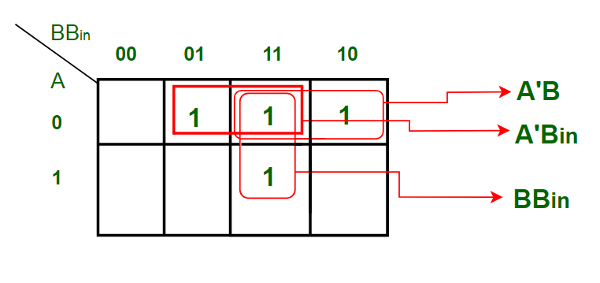
Full Subtractor
K-map Simplification for output variable ‘Bout‘ :
The equation obtained is: B_{out} = BB_{in} + A'B + A'B_{in}

Slide 26
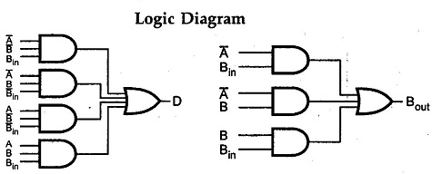
Full Subtractor
Logic Diagram of Full Subtractor:

Slide 27
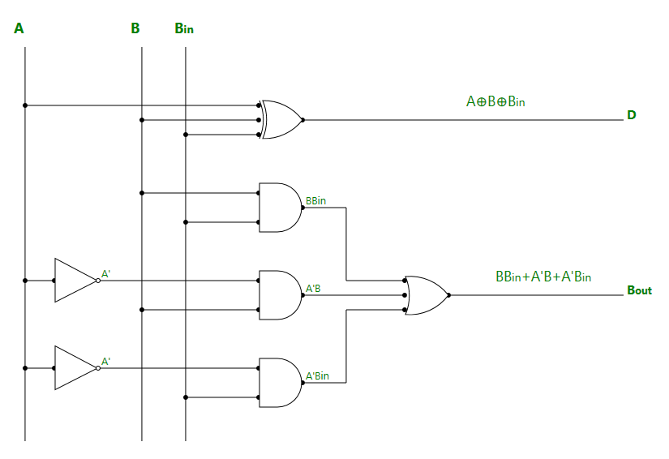
Full Subtractor
Logic Diagram of Full Subtractor:

Slide 28
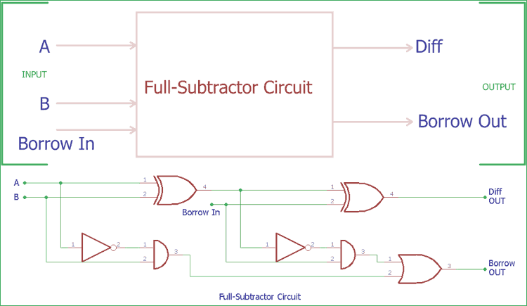
Full Subtractor
Logic Diagram of Full Subtractor:

Slide 29
Applications
Arithmetic Operations
ALU (Arithmetic Logic Unit)
Digital Signal Processing (DSP)
Memory Addressing
Data Compression and Encryption
Digital Counters and Timers
Control Systems
Image and Video Processing
Data Address Calculation
Floating-Point Arithmetic
Error Detection and Correction

Slide 30
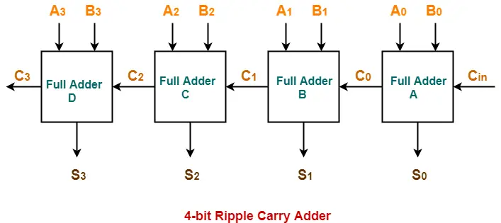
Ripple carry adder

Slide 31
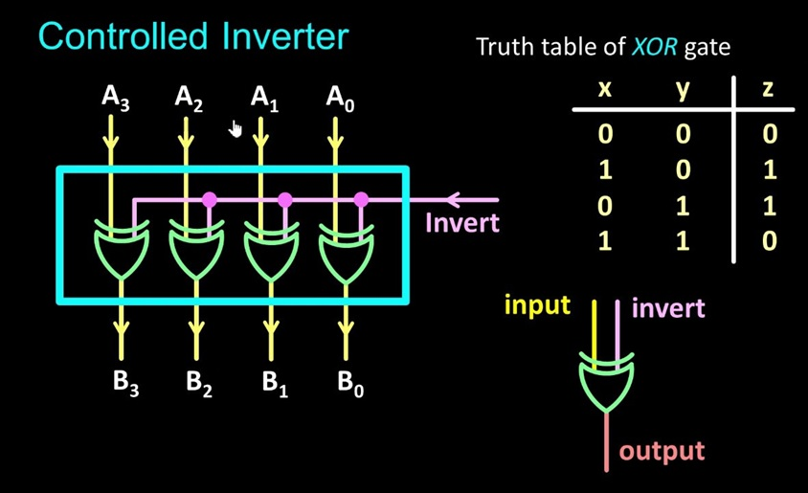
CONTROLLED INVERTER Circuit

Slide 32
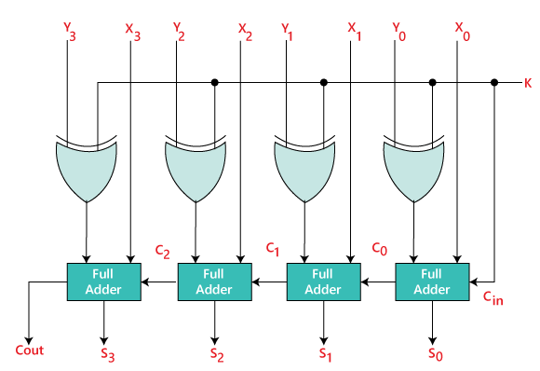
Binary Adder-Subtractor

